Slide 1

Techno-economic analysis of electrified high temperature reactor with conventional processes
Nils Schüler

Slide 2
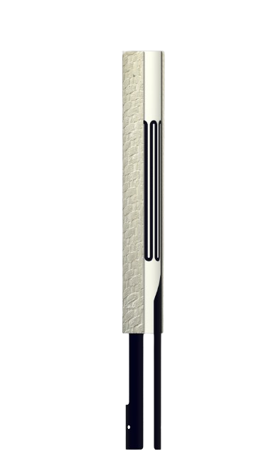




Electrically heated reaction zone and >500°C heat integration in one reactor
OCMC multilayer structure
Upscaled bundle
Gas-tight inner tube from Al₂O₃
Metallic heating element made of Aluchrom Y Hf
Oxide ceramic matrix composite (OCMC) for mechanical reinforcement
H₂+ CO
CH₄+ H₂O
Reactor Concept
Heat exchanger
$${\dot{Q}}_{H}$$
Heat recovery
OCMC
Standard monolithic ceramic inner tube
6 mm
$$L_{R}=f(kinetics)$$
20 mm
$$L_{HX}=f(heat transfer)$$
Heated reaction zone
$${\dot{Q}}_{el}$$
8 mm

Slide 3
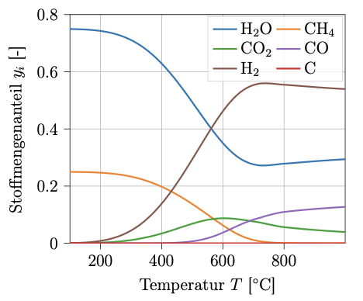
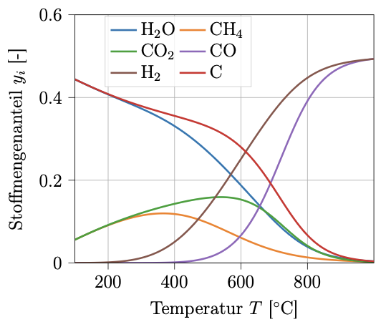
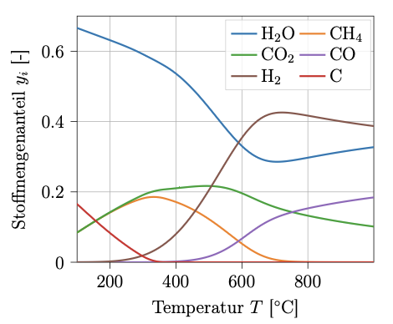


Potential for catalyst free gas phase reaction would allow smaller reactor design and lower costs
Thermodynamic equilibria (1 bar)
High temperatures lead to better equilibrium yields
And faster reaction
High pressures lead to worse equilibrium yields (SMR), but temperature can compensate for that
And faster reaction
Steam methane reforming CH_{4​} + H₂​O ⇌ CO + 3 H₂
Dry reforming of methane CH₄​ + CO₂ ⇌ CO + H₂
Bi-reforming of methane CH₄​ + CO₂ ⇌ CO + H₂
Kinetics
$r=k∙{p_{A}}^{α}$ ${{∙p}_{B}}^{β}$
$$with k\left(T\right)=A∙e^{−\frac{E_{A}}{RT}}$$
Notes:
Underlying motivation: High

Slide 4
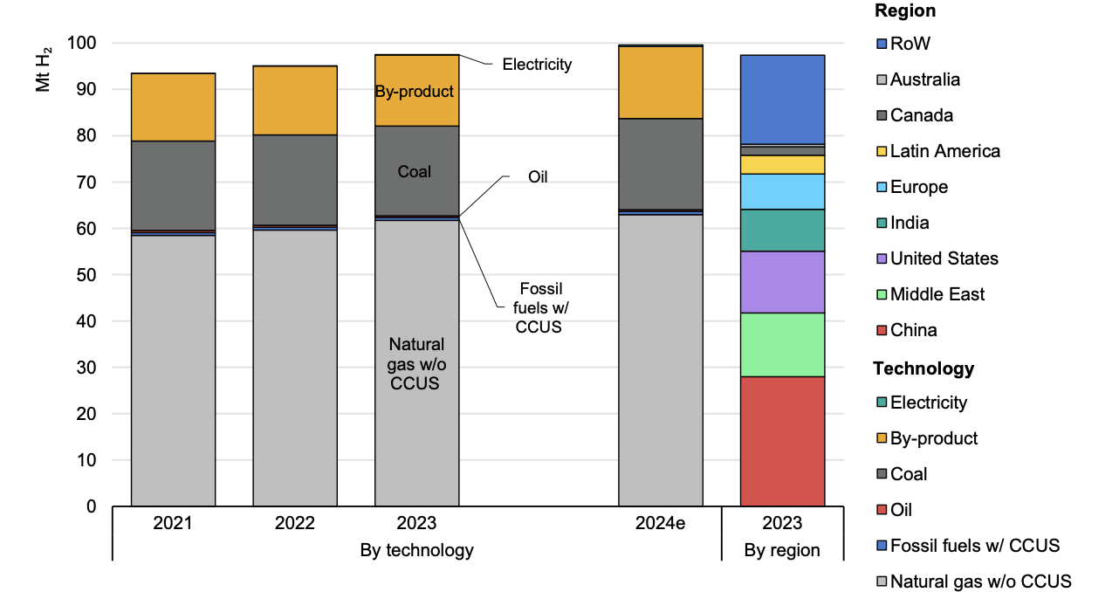
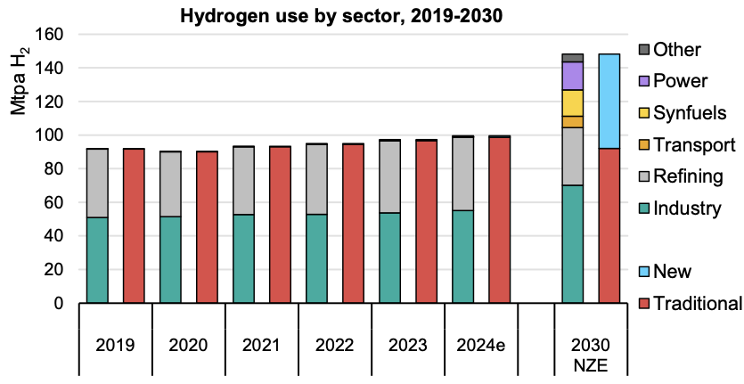
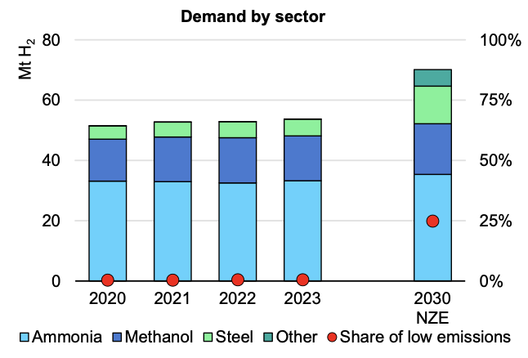
The SMR process is the current state-of-the-art process in varied designs for different sectors and should be used for comparison
Not most up to date data (2024)
Hydrogen production by technology and by region, 2021-2024
Sectors:
44% Refining (hydrotreating & hydrocracking)
33% Ammonia
17% Methanol
6% Steel
Future Outlook:
Refinery demand is assumed to reduce
Industry demand to increase, primarily driven by steel
Main regions differentiate significantly in cost structures
SMR is main process
Hydrogen demand by sector, 2019-2030 Breakdown of industry, 2020-2030
Notes:
97 Mt total
43 Mt industry
32,4 Mt ammonia
16,2 Mt methanol
5,4 Mt steel

Slide 5
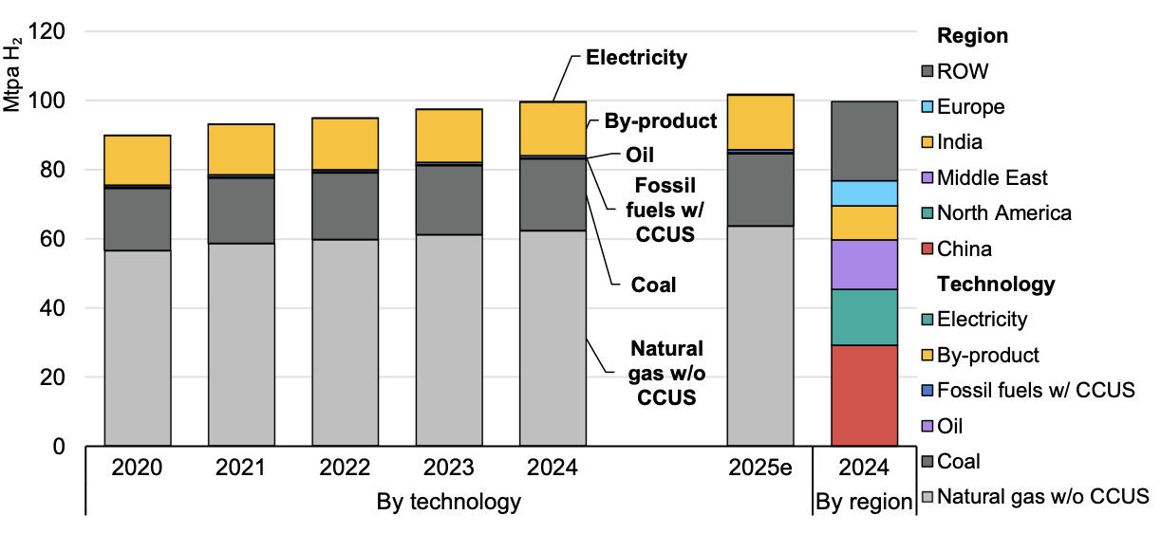
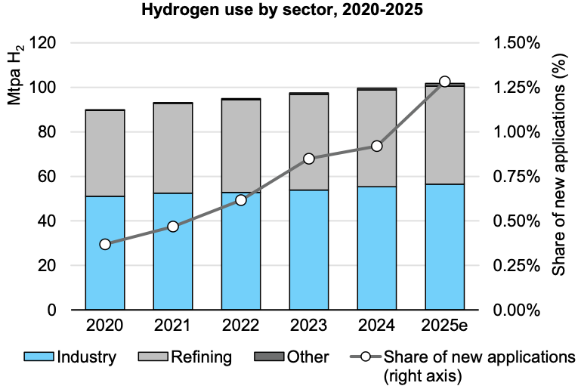
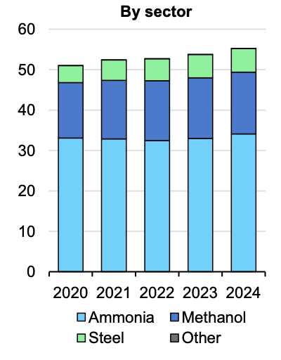
The SMR process is the current state-of-the-art process in varied designs for different sectors and should be used for comparison
Hydrogen production by technology and by region, 2020-2025
Main regions differentiate significantly in cost structures
Sectors:
45% Refining (hydrotreating & hydrocracking)
33% Ammonia
17% Methanol
5% Steel
SMR is main process
Hydrogen demand by sector, 2012-2025 Breakdown of industry, 2020-2024
Notes:
2024:
100 Mt total
55 Mt industry
33 Mt ammonia
16,5 Mt methanol
5,5 Mt steel

Slide 6
The hydrogen SMR process is used for the preliminary high-level comparison with our new reactor system
steam
Hydrogen
steam
Ammonia
steam
Methanol
HX
HX
HX
1200°C
3:1 H₂/N₂
2:1 H₂/CO
NG
SMR
WGS
PSA
H₂
NG
SMR
ATR
WGS
CC
Meth
NG
SMR
ATR
CC
air
ATR reactions
POx: CH₄​ + 2 O₂​ → CO₂​ + 2 H₂​O (ΔH = -806 kJ/mol)
SMR: CH₄​ + H₂​O ⇌ CO + 3 H₂​ (ΔH = 233 kJ/mol)
Why two reactors? Enough O₂ for heat balance = 0 leads to too much N₂ (air: 80% N₂) for a 3:1 ratio
Why no external heating of ATR instead of more air?
Constraint by adiabatic reactor design (refractory lining)
Why not air in SMR?
Material constraints: Exothermic reaction leads to too high temperatures
Downsides
Higher electricity input
Additional unit
Purge for avoidance of N2 enrichment in recycle
Upsides
Lower NG input
Captured CO₂
Downsides
Less worldwide production capacity than H₂ and NH₃
Less literature
Upsides
CO₂-sink
steam
B
steam
steam
CO₂
>150 bar is possible!
3:1 H₂/N₂
NG CO₂
2:1 H₂/CO
NG
eSMR
WGS
CC
PSA
NG
eATR
WGS
CC
Meth
e2MR
CC
Additional unit!
air
CC-unit already in conventional process!
Elect.
Elect.
Elect.
The additional unit operations required suggest hydrogen SMR to be the least competitive with conventional processes.
A preliminary high-level comparison of these processes is conducted under certain simplifications, assuming that any competitive potential identified applies across all processes.

Slide 7
The eSMR process leads to an overall simplified flow scheme with reactor internal heat recovery, rather than complicated byproduct steam production
High-level comparison of conventional SMR vs. eSMR
MP steam export
Flue gas
HXA
HX2
Water
Waste water
NG
HXF
NG desulph.
HX1
SMR
HX3
WGS
HXF
HX5
PSA
H2
HX4
HXA
H2 compression
Air
HP Steam
One reactor unit
Waster water
CO2
NG
HXF1
HXF2
NG desulph.
HX1
eSMR
HX1
HXF2
WGS
HXF1
CO2 removal (Std. Rectisol)
PSA
H2
Recycle gas compression
Electricity

Slide 8
High-level economic evaluation
High-level economic evaluation
HP Steam
One reactor unit
Waster water
CO2
NG
HXF1
HXF2
NG desulph.
HX1
eSMR
HX1
HXF2
WGS
HXF1
CO2 removal (Std. Rectisol)
PSA
H2
Recycle gas compression
Electricity
→ Excel

Slide 9
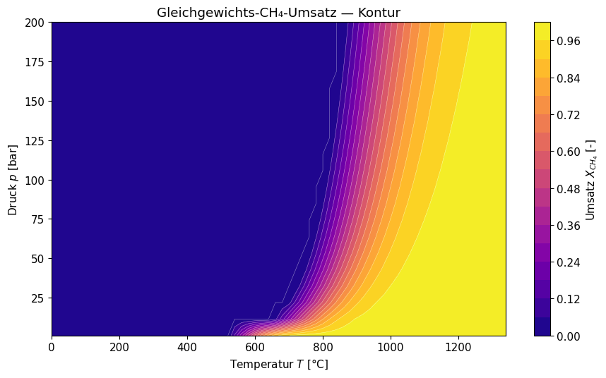
Ammonia offers better potential since the plant configuration is streamlined and operation at higher pressure with yet high yields is possible due to 1100 °C
SMR: CH₄​ + H₂​O ⇌ CO + 3 H₂​
Increase in mole number
Compression before reforming is at anincentive
1
Conventianol ATR
2
Still reasonable yields in eATR, but recycle necessary
2
Current pressure limitation due to tube material constraints
1
Ammonia production via eATR is assumed to be best for detailed TEA

Slide 10
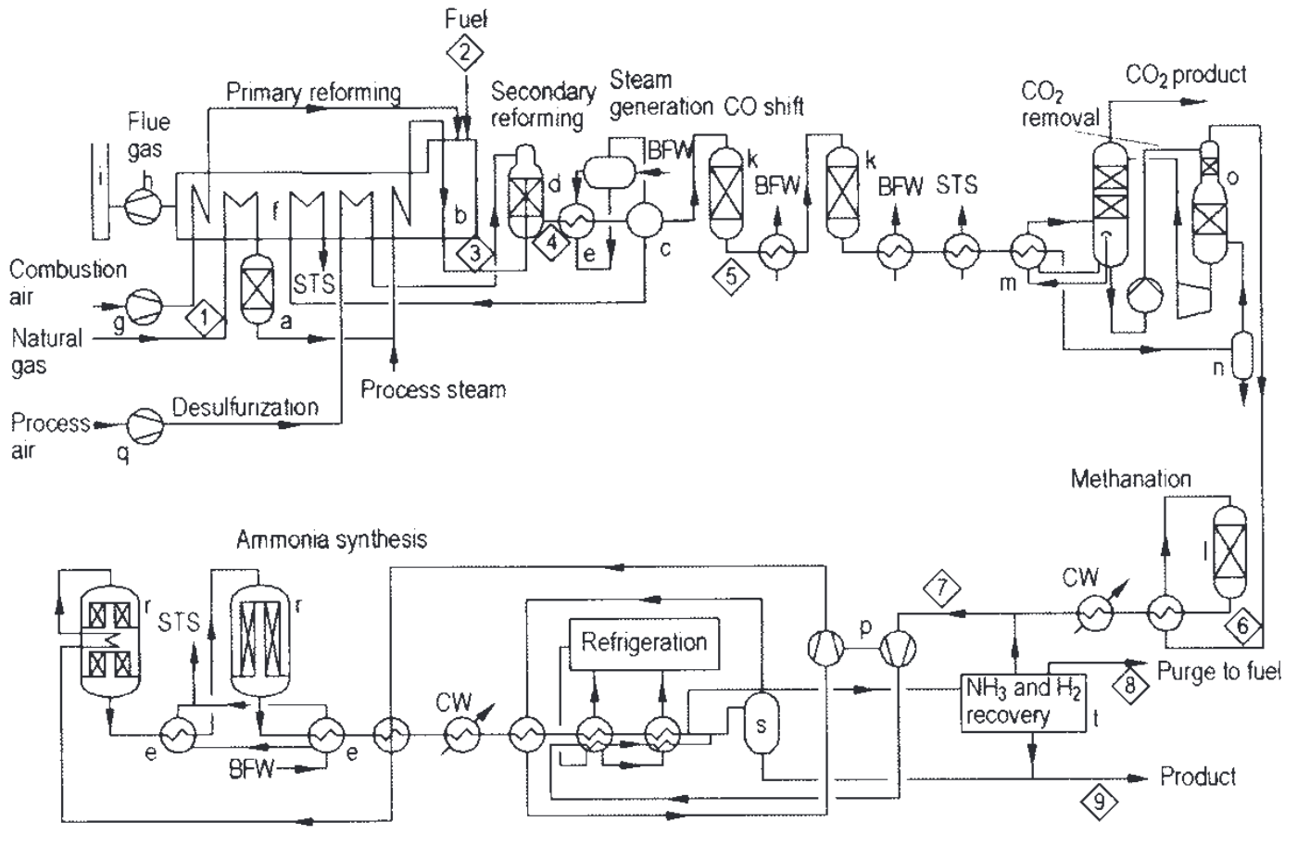
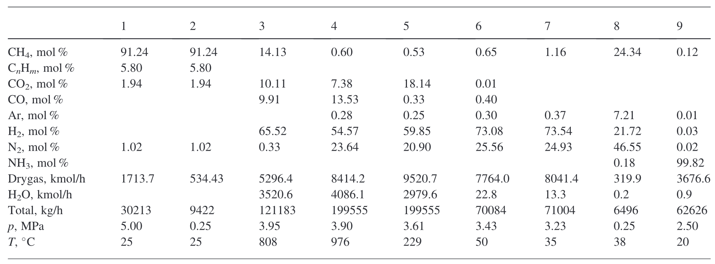
Building reference PFD from Ullmann’s example
Reference case: Ullmann’s modern integrated single-train ammonia plant (2011)
Main similarities:
CO2 removal
Methantion
Ammonia synthesis
Main differences:
Higher pressure (compression of fever moles upstream than downstream)
Recycle (compression of recycle stream)
1 instead of 2 reactors
Neglect in PFD?

